Slide 1
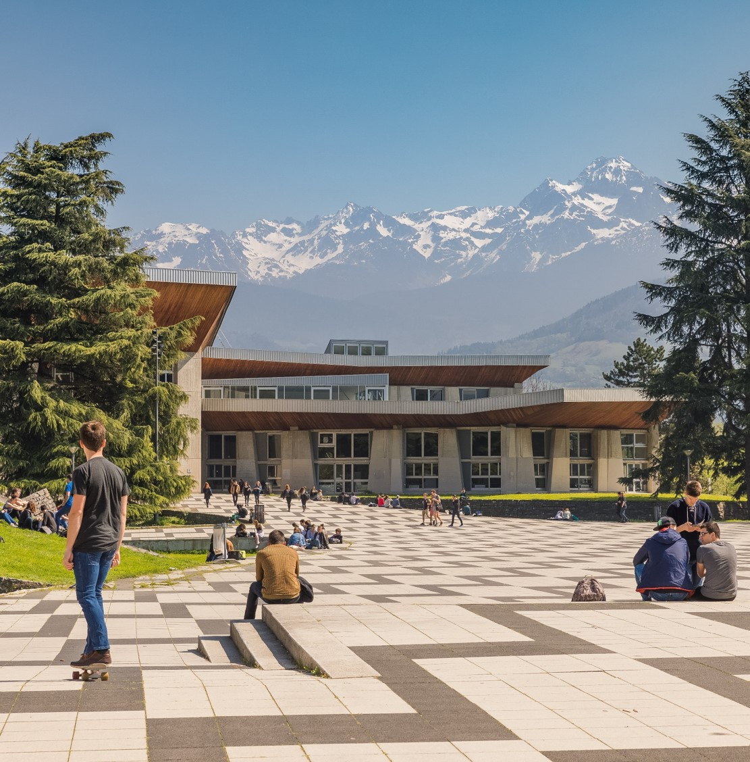
Discover
Université Grenoble Alpes
Education, research, innovation
in a cutting edge environment
Name of the Speaker
--/--/202-

Slide 2
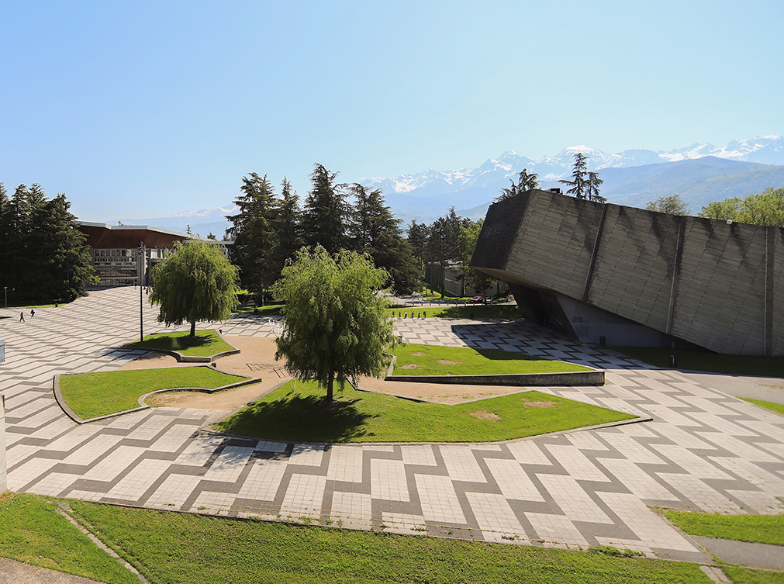

Who we are?

Slide 3
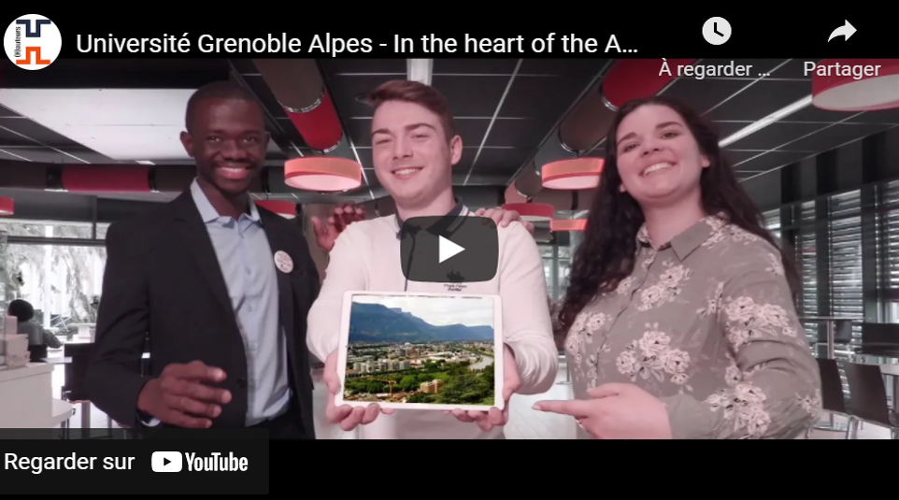

Université Grenoble Alpes, in the heart of the Alps
See what UGA has to offer!
Notes:
Video url https://www.youtube.com/watch?v=19AZEDP5wZk
Control + click sur l’image pour accéder à la vidéo

Slide 4
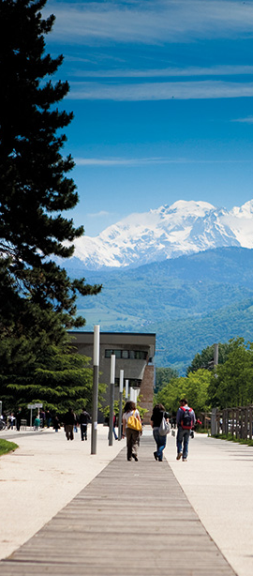

UGA facts and figures
Our students
  59,000 students, including 10,000 international students
  160 nationalities
Our staff
  7,700 employees including 4000 teaching and faculty members
Our research
  75 research centers and 1 teaching hospital
  166 active start-ups
  Over 260 joint doctoral thesis with a foreign university
Our academic offer
  400 programs, 70 of which taught in English
  128 international collaborative degree programs
  3 Erasmus Mundus joint Master’s degrees
  1,500 exchange agreements

Slide 5
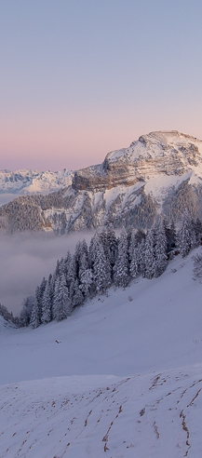
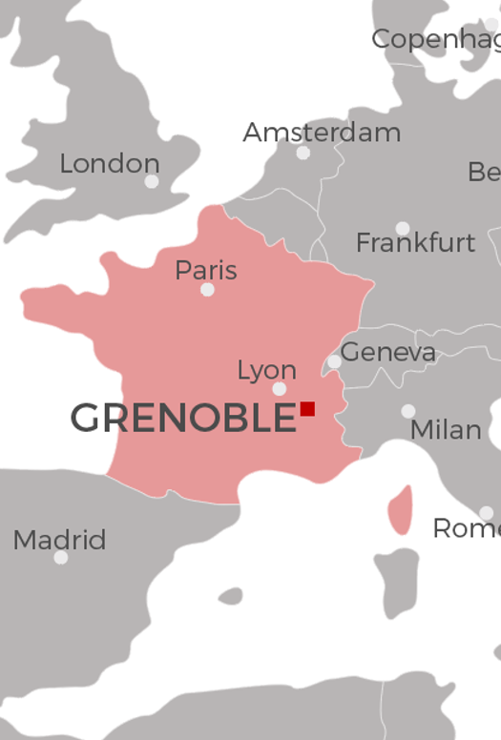
An exceptional environment
Nestled in the heart of the Alps
Amazing landscapes and sights in the mountains around Grenoble
A wide variety of outdoor activities: hiking, climbing, skiing,
trail running, cycling…
Close to world-famous ski resorts
Central location
3h by train from Paris
1h40 by car from Geneva
1h by car from Lyon international airport
Driving distance of Paris, the Mediterranean coast, and neighboring European countries (Germany, Belgium, Italy, Spain, Switzerland)
Notes:
680,000 inhabitants in Grenoble

Slide 6
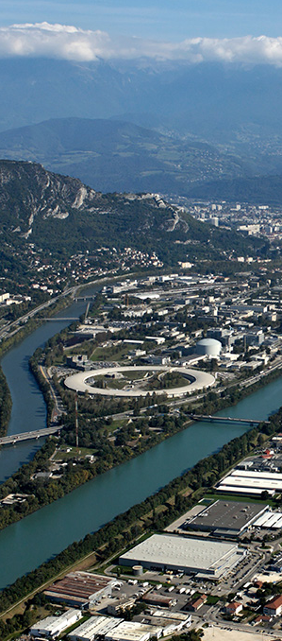

Synergy between research and industry
5 International laboratories and instruments
  ESRF, ILL, EMBL, GHMFL, IRAM
8 National research organizations
  CNRS, CEA, Inria, Inserm, INRAE, CRSSA, IRD, CHU Grenoble Alpes
Major companies
  Sun Microsystems, HP, Orange, STMicroelectronics, Schneider Electric, Alstom, Xerox, Thales…
France’s Initiative of Excellence (IDEX) accreditation
  Grenoble laureate in 2016, confirmed in 2021
  Selected by an international committee
  Only awarded to 8 universities in France
Notes:
5 international instruments:
ESRF: European Synchrotron Radiation Facility
ILL: Institut Laue Langevin Neutron-flux reactor
EMBL: European Molecular Biology Laboratory
GHMFL: Grenoble High Magnetic Field Laboratory
IRAM: Institute of millimetric Radio astronomy
8 national research organizations:
CNRS: Centre National de Recherche Scientifique, France’s most important research organization, all disciplines
CEA: French Alternative Energies and Atomic Energy Commission
Inria: French National Institute for computer science and applied mathematics
Inserm: Institute dedicated to biomedical research and human health
INRAE: French National Research Institute for Agriculture, Food and Environment
CRSSA: Research center focusing on health and medical research for the French armed forces (??Grenoble only?)???
IRD: French National Research Institute for Sustainable Development
CHU: Grenoble Alpes University Hospital
Idex label is a government-backed program which aims at creating internationally competitive centers of excellence in higher education and scientific research.
UGA is one of 8 universities in France to have obtained this accreditation and confirmation.

Slide 7

2021 International rankings
Top 150 in Shanghai Ranking
of World Universities
Top 50 worldwide in 6 subjects:
Remote sensing, Earth Sciences, Metallurgical Engineering, Physics, Clinical Medicine, Mining and mineral engineering
33rd most innovative university
in Europe - Thomson Reuters
Top 200 QS World Ranking
Top 100 universities in: Earth & Marine Sciences, Geology and Geophysics and Top 150 in Linguistics, Materials Sciences and Physics & Astronomy
Notes:
https://www.univ-grenoble-alpes.fr/francais/classement-thematique-de-shanghai-2021-l-universite-grenoble-alpes-confirme-sa-place-de-premiere-universite-en-region-873011.kjsp?RH=2320611992734654
https://www.shanghairanking.com/institution/universit%C3%A9-grenoble-alpes
UGA, 1st French university in:
Metallurgical Engineering (30, 1st in France)
Geography (51-75, 1st in France)
Nanoscience and Nanotechnology (76-100, 1st in France)
Water Resources (51-75, 1st ex aequo in France)
Hospitality and tourism management (201-300, 1st ex aequo in France)
Out of the 54 subjects that were evaluated, the UGA is ranked 37 times: it appears 7 times in the top 50, 11 times in the top 100, 9 times in the top 200 and 7 times in the top 300.
The UGA is in the top 50 in 6 subjects
Earth Sciences: 25, 4th in France
Remote Sensing: 34, 2nd in France
Metallurgical Engineering: 18, 1st in France
Mining and mineral engineering: 48, 3rd in France
Physics: 39, 6th in France
Clinical Medicine: 45, 3rd in France
UGA is in the top 100 in 11 subjects
Geography : 51-75, 1st in France
Water Resources : 51-75, 1-3 ex-aequo in France
Atmospheric Science : 51-75, 3-5 ex-aequo in France
Ecology : 51-75, 7th in France
Nanoscience and Nanotechnology : 76-100, 1st in France
Computer Science & Engineering : 76-100, 2-3 ex-aequo in France
Oceanography : 76-100, 7-9 ex-aequo in France
Electrical & Electronic Engineering : 76-100, 2nd in France
Automation & Control – 76-100, 4the in France
Environmental science and engineering : 76-100, 2nd in France
Pharmacy and pharmaceutical sciences : 76-100, 5th in France
UGA is in the top 200 in 9 subjects
Chemistry : 101-150, 4-5 ex-aequo in France
Energy science and engineering : 101-150, 3-4 ex-aequo in France
Materials science and Engineering : 101-150, 2-3 ex-aequo in France
Agricultural sciences : 101-150, 8-10 ex-aequo in France
Civil Engineering : 151-200, 3rd in France
Instrument science and technology : 151-200, 2nd in France
Medical technology : 151-200, 8-10 ex-aequo e in France
Statistics : 151-200, 8-12 ex-aequo in France
Mechanical engineering : 151-200, 4-10 ex-aequo in France
UGA is in the top 300 in 7 subjects
Biomedical Engineering : 201-300, 5-10 ex-aequo in France
Biological sciences : 201-300, 12-15 ex-aequo in France
Hospitality and tourism management : 201-300, 2nd in France
Chemical engineering : 201-300, 3-9 ex-aequo in France
Human biological sciences : 201-300, 11-13 ex-aequo in France
Public health : 201-300, 5-7 ex-aequo in France
Management : 201-300, 7-10 ex-aequo in France

Slide 8


Academic offer

Slide 9

A comprehensive academic offer
Undergraduate and postgraduate programs in a wide range of disciplines
All of our programs include the possibility of international mobility with one of our 1,000 institutional partners.
Short programs: thematic or interdisciplinary summer schools, and tailored-made programs with international partner universities
Discover UGA Program catalog
Find a program in English
Notes:
Find a program in English:
https://www.univ-grenoble-alpes.fr/studyinenglish/
Find a program in French:
http://formations.univ-grenoble-alpes.fr/

Slide 10
UGA Academic structuration
Our faculties, schools and institutes
Faculty of Humanities, Health, Sports and Society
  Chemistry and Biology Department
  IM2AG Department
  (Computer Science, Mathematics and Applied Mathematics)
  PhITEM Department
  (Physics, Engineering, Earth sciences, Environment and Mechanics)
  OSUG (Grenoble Earth Sciences and Astronomy Observatory)
  Science & Technology Undergraduate Department
  School of Arts and Humanities
  School of Foreign Languages
  School of Language, Literature, Performing Arts, Information and Communication
  School of Human and Social Sciences
  School of Physical and Sporting Techniques and Activities
  School of Medicine
  School of Pharmacy
Faculty of sciences
  Department IUT1 (Sciences and technologies)
  Department IUT2 (Social sciences and technologies)
  Department IUT of Valence
  (lnformation and communication sciences and technologies)
Faculty of Economics of Grenoble
University School of Technology
Grenoble Law School
Alpine Geography and Urban Planning Institute
Grenoble INP
Institute of Engineering and Management
ENSAG
School of Architecture
Sciences Po Grenoble
School of Political Studies
Drôme Ardèche Sciences Department
Language Service (SDL)
  University Center for French Studies (CUEF)
  Teaching and Education School (INSPE)
Doctoral College (CED)

Slide 11
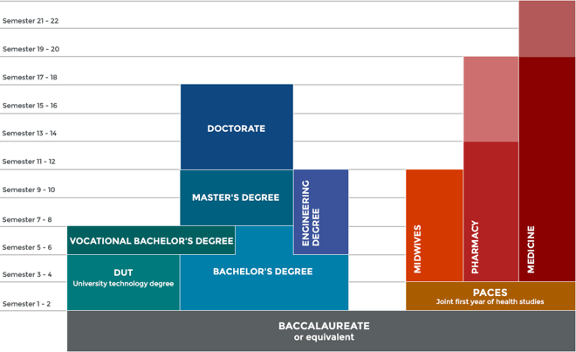
Study in France
The French Higher Education system
Higher education in France is organized in three levels:
the Licence and licence professionnelle (bachelor's degrees),
the Master (Master’s degree),
and Doctorat (PhD).
Academic year
1st semester: September to December/January
2nd semester: January to May/June

Slide 12

Study in France
French Universities use the European Credit Transfer System (ECTS) which are awarded for successfully completed studies: one academic year corresponds to 60 ECTS, one semester to 30 ECTS.
Level of study | Bachelor (180 ECTS) |  |  |  |  |  | Master (120 ECTS) |  |  |  | PhD (180 ECTS)
Years | L1 (Licence 1) |  | L2 (Licence 2) |  | L3 (Licence 3) |  | M1 (Master 1) |  | M2 (Master 2) |  | D1 (Doctorat 1) |  | D2 (Doctorat 2) | D2 (Doctorat 2) |  | D3 (Doctorat 3) | D3 (Doctorat 3)
 | 1 |  | 2 |  | 3 |  | 4 |  | 5 |  | 6 |  | 7 | 7 |  | 8 | 8
ECTS/year | 60 |  | 60 |  | 60 |  | 60 |  | 60 |  | Thesis: 150 Additional training: 30
Semesters | 1 | 2 | 3 | 4 | 5 | 6 | 7 | 8 | 9 | 10 | 11 | 12 |  | 13 | 14 |  | 15 | 16

Slide 13

UGA ‘‘Graduate Schools’’
Preparing students for doctoral research or
direct professional integration.
Scholarships to attract the best international students
Funding for international research experience
Internships in research laboratories
International visiting researchers
GS@UGA
75 master's degree courses
15 thematic programs
13 PhD schools involved
Chemistry Biology Health (CBH) graduate school
25 master’s programs
2 doctoral schools
Notes:
https://www.univ-grenoble-alpes.fr/universite/ambition-et-strategie/la-graduate-school/la-graduate-school-gs-uga-900243.kjsp?RH=1594806150940
https://www.univ-grenoble-alpes.fr/about/ambition-and-strategy/graduate-school/graduate-school-gs-uga-900388.kjsp?RH=1579599905156
https://www.univ-grenoble-alpes.fr/recherche/projets-structurants/la-graduate-school-chimie-biologie-sante/la-graduate-school-chimie-biologie-sante--709330.kjsp?RH=1594806150940

Slide 14

Resources for international students
A web portal dedicated to international students:
https://international.univ-grenoble-alpes.fr/english/
Choose your program:
https://international.univ-grenoble-alpes.fr/come-to-uga/degree-programs/
Scholarships and financial aids:
https://international.univ-grenoble-alpes.fr/come-to-uga/scholarships-and-financial-aid/
Information about registration fees:
https://www.univ-grenoble-alpes.fr/registration-fees/
How to apply:
https://www.univ-grenoble-alpes.fr/education/how-to-apply/

Slide 15
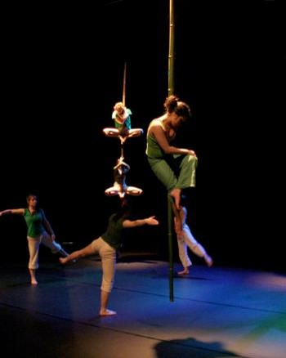
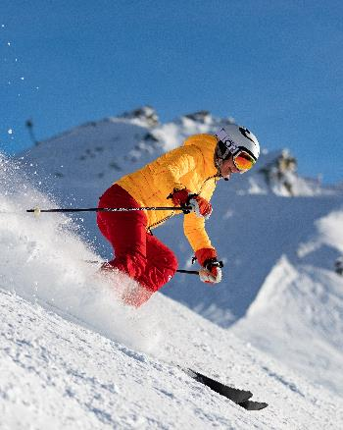
Services for students with specific needs
Handicapped students, staff, faculty, and visitors
Accessible facilities, services, studies, and student life
Exchange students
Orientation activities, special language, culture classes, and other activities designed to ease integration of exchange students
Migrants in Exile
Services for students and scholars in exile
Student athletes
The status “sportif de haut niveau” allows high-level athletes to pursue their goals without sacrificing their education
Student artists, student entrepreneurs, students in service
Additional resources and specially adapted course schedules allow students to pursue their studies while starting a business, working as an artist, or serving in the military, fire department or local government
Notes:
Aménagement d’études : https://www.univ-grenoble-alpes.fr/formation/modalites-de-formation/amenagement-d-etudes-pour-les-etudiants-a-besoins-specifiques/
Migrants/refugees : https://campus.univ-grenoble-alpes.fr/fr/menu-principal/droits-et-soutien/migrants-refugies-ou-demandeurs-d-asile/

Slide 16

Services for international students
Personalized help and assistance
International Students and Scholars Office (ISSO)
On-campus immigration office
Language and culture courses designed specifically for exchange students
One of the oldest university centers for the study of French: CUEF de Grenoble
An international student association: IntEGre
Colibri office for refugees students and scholars
Notes:
Office locations and contact info for Grenoble, Savoie, and Valence (English version):
https://international.univ-grenoble-alpes.fr/en/offices/offices/
On-campus immigration/préfeture (St. Martin d’Hères campus only):
Espace Accueil Information - Domaine Universitaire
1025 avenue Centrale - 38402 Saint Martin d'Hères
Tram B and/or C:
Station "Bibliothèques universitaires"
Opening hours : from Monday to Friday from 9 a.m. to 5 p.m. from September to December
Contact : isso@grenoble-univ.fr
Tél. 04 56 52 97 89
CUEF website:
https://cuef.univ-grenoble-alpes.fr/en/
Integre website:
https://en.integre-grenoble.org/

Slide 17
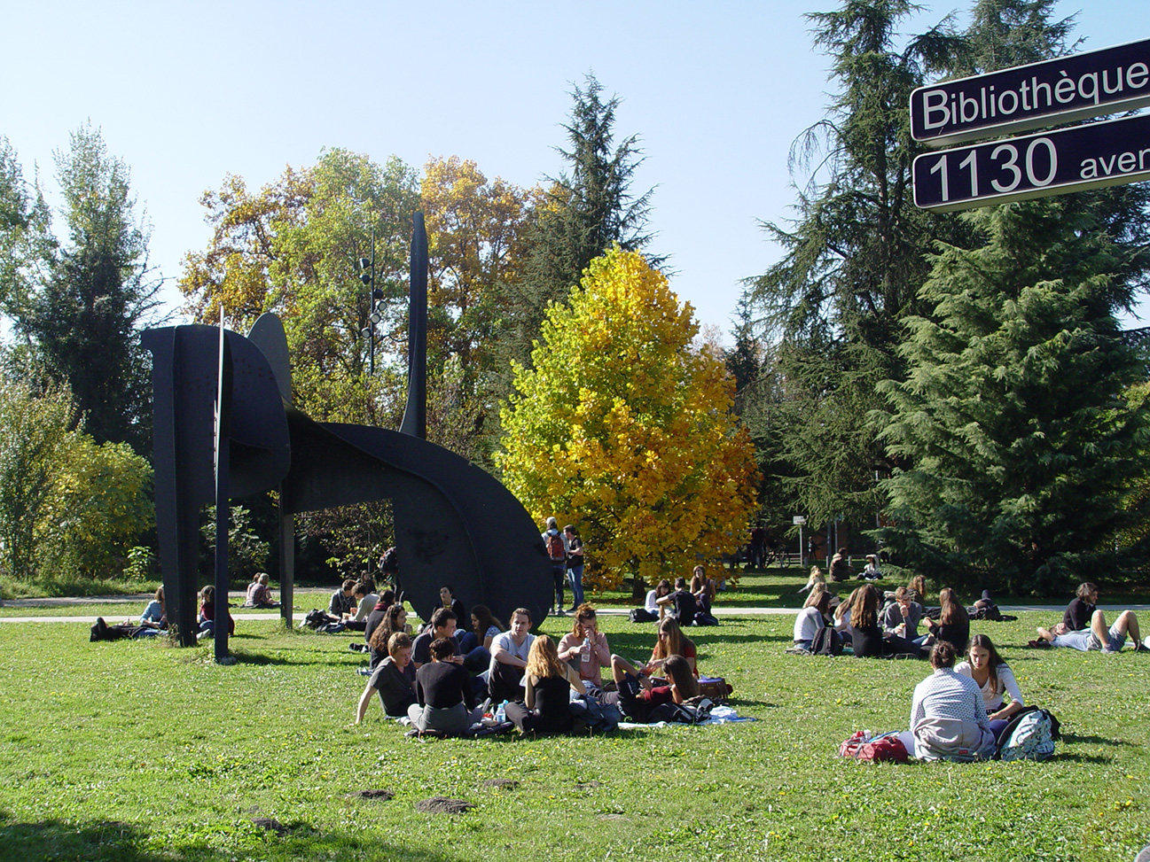

Student life

Slide 18
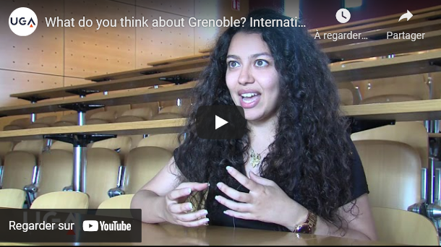
Grenoble: one of the best student cities in France
Ranked 6th best city to study in by l’Étudiant magazine
Bustling and diverse nightlife
Extensive and affordable public transportation system
100+ cultural events programmed each year for students
International student Safa Ali shares her experience studying in Grenoble.
Notes:
Video url: https://www.youtube.com/watch?v=yUqPuarfOeo
Control + click to open link

Slide 19

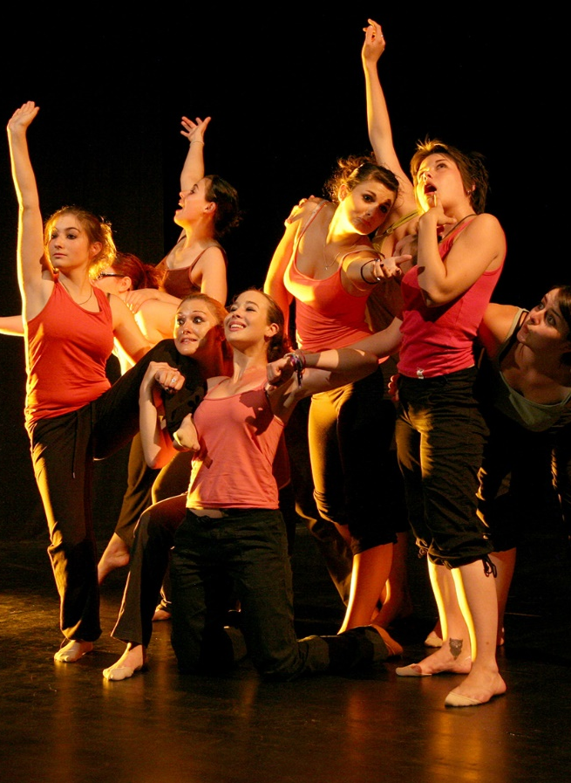

All-encompassing campus
EVE Student center
More than 300 student organizations
A student radio
2 university theaters
4 spaces dedicated to culture on campus
Health center
More than 45 formal sports classes, plus an additional 30+ ungraded activities.
Access to Olympic swimming-pool, climbing walls, several sport fields and equipment.
Easily accessible by bus, tram, or bike
Notes:
Sport infrastructures: olympic swimming pool, climbing walls, sport halls and grounds…

Slide 20
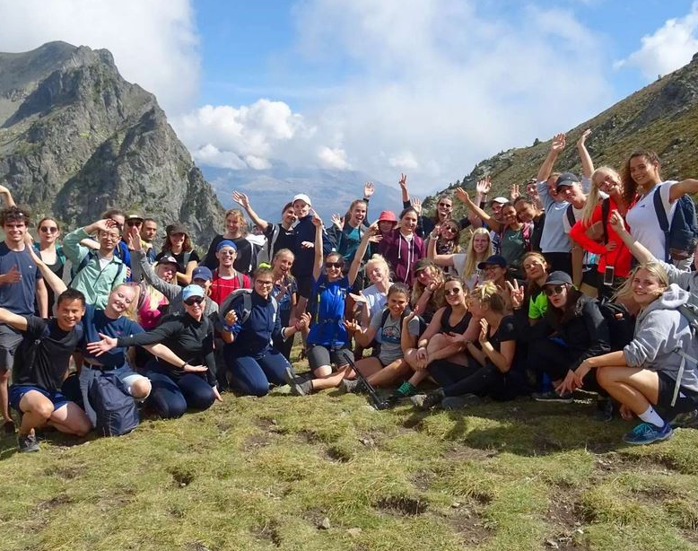

IntEGre: international student association
Bringing together French and international students thanks to:
    Student mentoring program
    Language duos
    Campus and city tours for new international students
    Exchange of household items for incoming students
Notes:
https://www.integre-grenoble.org/
Control + Click on Facebook logo to go to IntEGre FB page

Slide 21
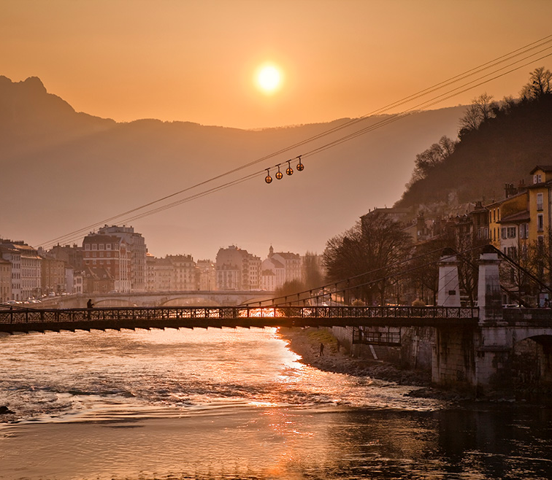
Thanks for your attention

